Slide 1
Heart Health Prediction
Team: Ryan Bouapheng, Ritesh Dumpala, Faith Nnakwe
Data Mining: Jingyu Li

Slide 2
Why Heart Health Matters
“Cardiovascular disease is a leading cause of death worldwide, yet many cases are preventable through early detection and risk assessment.” (Resource)
“In the U.S., cardiovascular disease causes one death every 34 seconds, and 919,032 people died from it in 2023.” (Resource)
“Heart disease cost about $417.9 billion from 2020 to 2021. This includes the cost of healthcare services, medicines, and lost productivity due to death.” (Resource)
Notes:
What problem are we trying to solve? Why should we care about this problem?
“Heart disease remains one of the leading causes of death worldwide. Many risk factors—like blood pressure, cholesterol, age, and lifestyle—can be tracked. This makes heart-health prediction an ideal domain for data mining, where identifying patterns early can save lives.”

Slide 3
Project Objective
The objective of this project is to develop an accurate and reliable predictive model that assesses an individual’s risk of cardiovascular disease using medical and lifestyle data.
Traditional screening methods may overlook subtle, multi-factor interactions present in patient data. There is a need for data-driven predictive tools that can analyze complex medical and lifestyle indicators to accurately identify individuals at high risk.
This project seeks to address this gap by developing machine learning models capable of supporting early intervention and improved clinical decision-making.
Notes:
“Our goal was to evaluate different data-mining techniques to determine which method best predicts heart-disease risk.”

Slide 4
Dataset Summary
Key Features
Age
Gender/Sex
Chest pain type
Resting blood pressure
Serum cholesterol
Fasting blood sugar
Resting electrocardiographic results
Maximum heart rate achieved
Exercise-induced angina
ST depression (oldpeak)
Slope of ST segment
Number of major vessels
Target (heart disease indicator)
Table/Summary
Number of rows: 1,000
Number of attributes: 14
Source: Provided patient cardiovascular dataset sample
Notes:
What does our dataset contain?
“We used the well-known heart-disease dataset with 303 samples and 13 features. It includes demographic information, test results, and symptoms. The target variable indicates whether heart disease is present.”

Slide 5
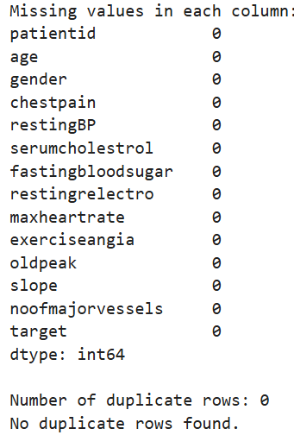
Data Preprocessing
Missing Values → Encoding (one-hot) → Normalization → Train/Test Split
Notes:
“To prepare the dataset, we handled missing values, encoded categorical features like chest-pain type and thal, normalized numerical variables, and split the dataset into training and testing sets for fair model evaluation.”

Slide 6
Analyzing the Data
• Performed full EDA
• Multiple visualizations for clinical features -
Box Plots, Count plots, Violin plots, KDE, jointplots, heatmaps, ROC curves, etc.
• Feature correlation & importance analysis
• Standardization where required
• Stratified train-test split
• Multiple ML models compared
• Evaluated with Accuracy, Precision, Recall & F1-score
Feature Importance: Number of Major Vessels, ST Depression (oldpeak), Chest Pain Type (chestpain), Maximum Heart Rate, Age, Slope

Slide 7
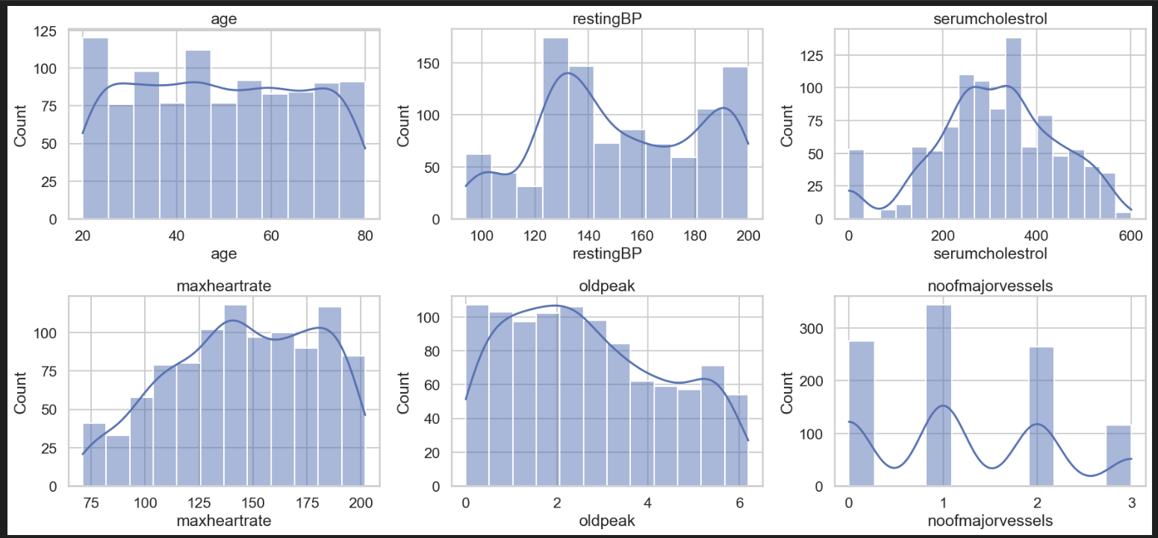
VISUALIZATION
Histograms of Numeric Features:
Plots show variation in important clinical features
Cholesterol and ST-depression differ greatly among patients
Understanding feature distributions improves model evaluation and selection

Slide 8
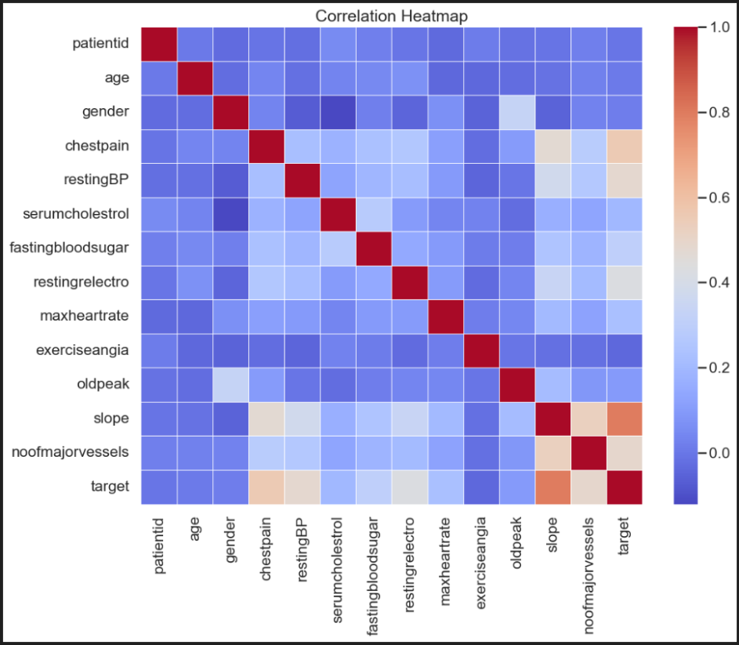
Correlation Heat Map
• Shows how strongly each clinical feature relates to heart disease (target).
• Oldpeak, chest pain, and number of major vessels show the strongest correlation with disease.
• Maximum heart rate shows a negative correlation → lower rates often indicate disease.
• Many features have low correlation with each other, reducing multicollinearity.
• Confirms that multiple independent signals help the model predict accurately.

Slide 9
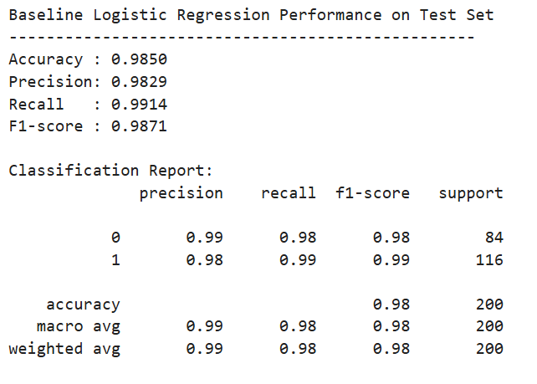
Logistic Regression
A statistical linear model used for binary classification
Predicts probability of heart disease (0 = No, 1 = Yes)
Fast, simple, and highly interpretable
98.5% accuracy
Notes:
We selected Logistic Regression as the final model because it offers equal performance with better interpretability.

Slide 10
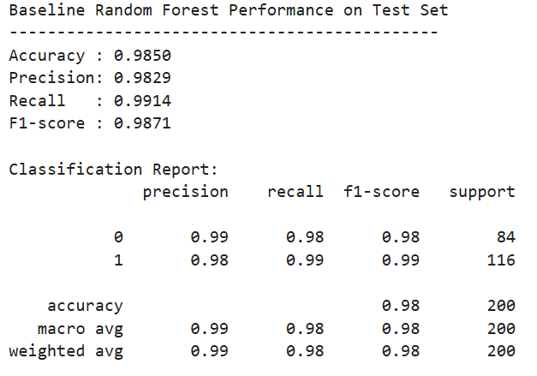
Random Forest
Ensemble of multiple decision trees
Reduces overfitting and improves prediction stability
Captures feature interactions well
Matches Logistic Regression performance
Notes:
We selected Logistic Regression as the final model because it offers equal performance with better interpretability.

Slide 11
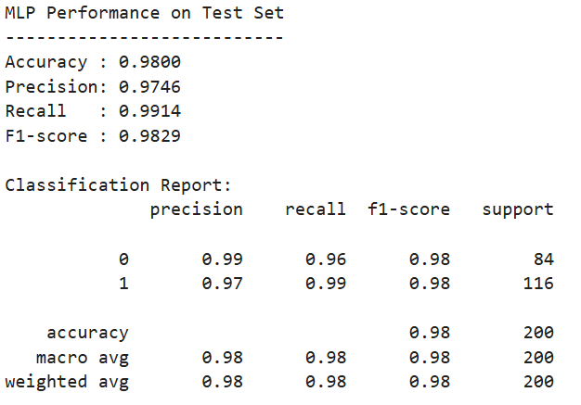
Multi-Layer Perceptron Learning
Learns complex nonlinear relationships in data
Uses interconnected neurons across hidden layers
Slightly lower performance due to model complexity
More computationally expensive than simpler models

Slide 12
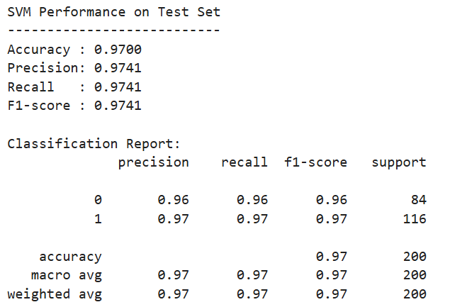
Support Vector Machine
Maximizes class separation using optimal decision boundaries.
Works well with high-dimensional feature spaces.
Computationally heavier for larger datasets.

Slide 13
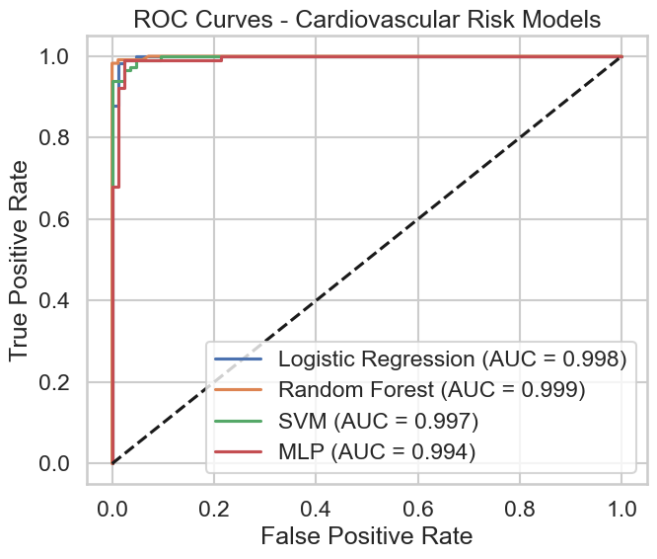
ROC Curves
Random Forest and Logistic Regression performed best, with nearly identical and near-perfect AUC values.
SVM and MLP also performed extremely well, though slightly below the baselines suggesting the dataset does not require deep nonlinear transformations.

Slide 14
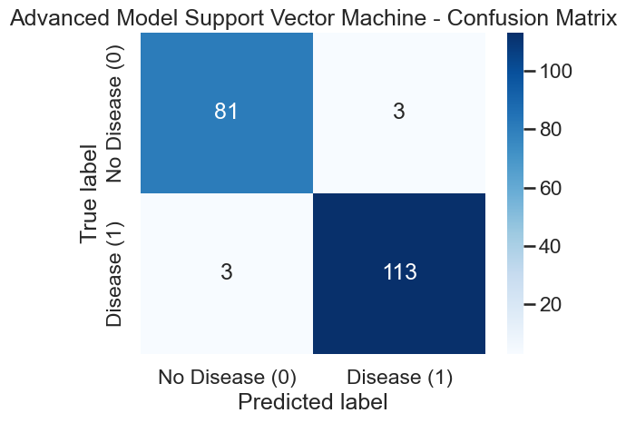
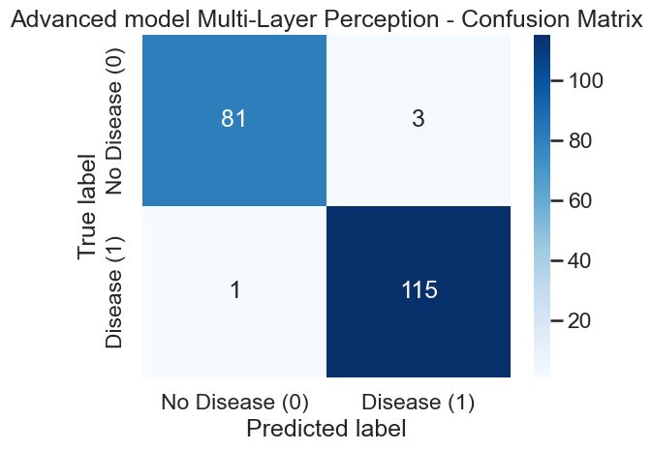
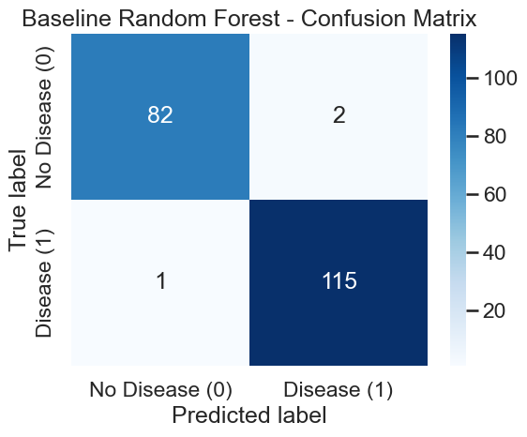
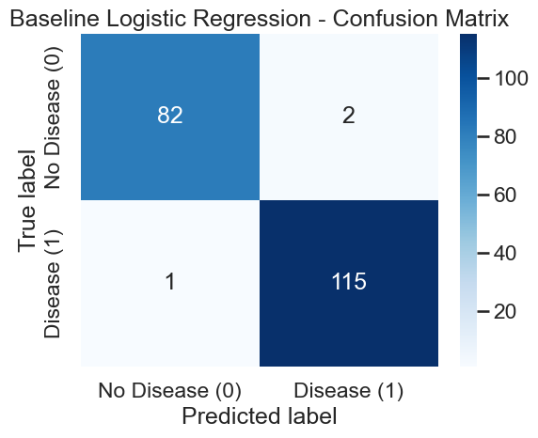
Confusion Matrix

Slide 15
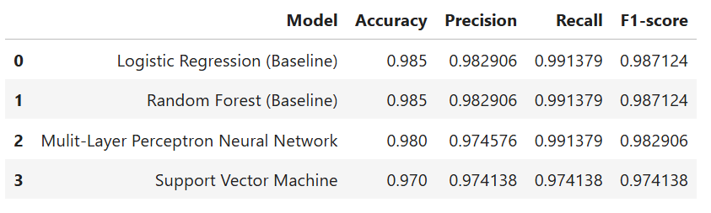
Results
Notes:
“Our results showed that the Random Forest model performed best, achieving around 90% accuracy and the highest F1-score. Logistic regression performed reasonably well, while the decision tree showed more variability. This suggests ensemble methods capture complex clinical patterns effectively.”

Slide 16
(Results of metrics)
Logistic Regression and Random Forest achieved the strongest overall performance.
Logistic Regression was selected as the final model due to its simplicity and interpretability.
Random Forest, while accurate, is less suited to this dataset because it learns complex nonlinear patterns that do not meaningfully exist in the data.
Logistic Regression provides clinically interpretable coefficients, allowing clear understanding of how each feature contributes to risk.
In healthcare, interpretability and simplicity are preferred when performance is comparable, making the linear model more appropriate for real-world use.

Slide 17
Conclusion
Logistic Regression achieved the highest accuracy and F1-score among all models tested.
Most influential features included chest pain type, max heart rate, ST depression, and age.
Limitation:
Logistic Regression assumes linear relationships between features and risk, which may oversimplify complex physiological interactions.
The dataset is limited to the features provided and may not capture all relevant clinical risk factors.
Future Improvements:
Incorporate a larger and more diverse dataset to improve generalizability across populations.
Explore additional clinical variables (e.g., lab results, family history, imaging data) to enhance predictive power.
Notes:
To conclude: data-mining techniques can effectively predict heart-disease risk. Logistic Regression models performed strongest in our analysis. With further refinement, these tools could help support early diagnosis and improve patient outcomes.

Slide 18
Thank you!

